Slide 1
16th Meeting of the South West Pacific Hydrographic Commission National Report by
PAPUA NEW GUINEA

Slide 2
Main achievements during the year
RAN Hydrographic Surveys over seven (7) Ports
Fugro ALB + MBES Surveys over 30 coastal areas
(6 packages) >95% completed
In Aug 2018, commenced promulgating coastal warnings via weekly email to S-53 MSI standard.

Slide 3
Main challenges and/or obstructions
Lack of awareness on importance of reporting MSI

Slide 4
Progress on surveys
RAN SURVEYS:
Hydrographic Ships
Lae / Madang
Laser Airborne Depth Sounder (LADS)
Kavieng / Rabaul / Vanimo / Wewak / Manus
These surveys over main ports in support of
APEC and Governments port expansion plans.
Notes:
Basically since the last SWPHC

Slide 5
Progress on surveys
FUGRO SURVEYS
North-East Coast – Louisiade Archipelago
Collingwood Bay / Egum Is / Esa’ala / Jomard Passage
New Britain Island
Cape Gloucester / Kandrian / Linden Hbr / Vitu Island
Conducted in support of Government
objectives to promote domestic shipping
and cruise tourism.
All data delivered to AHO for updating
nautical charts
ADB/PNG Maritime & Waterways Project
Notes:
Basically since the last SWPHC

Slide 6
Progress on charting
No changes to PNG coverage of AUS Chart scheme
Minor updates collected through chart investigation field trips and incoming reports. Changes or chart discrepancies are assessed using GIS application before Hydro Notes submitted to AHO.
Updates are published via the AHO fortnightly eNotices service.
Paper Charts | ENCs | Total
78 | 159 | 237

Slide 7
Progress on MSI
Commenced issuing coastal warnings in Aug 2018. Created email templates with text according to S-53 format. By end of year a total of 38 coastal warnings issued. 1 or 2 resulted in wider Navarea promulgation.
Service test conducted in Sep 2018 using Mailchimp application with the support of our ICT personnel. Mailchimp provided useful delivery reports for assessment and improvement.
Mailchimp also provided common platform to manage subscription, templates and workflow (drafting-approval-promulgation).
Navarea X Coordinator part of email circulation
AMSA rccaus@amsa.gov.au
AHO datacentre@hydro.gov.au
Warnings also available on website http://nmsa.gov.pg/notice-to-mariners/

Slide 8
Progress on MSDI
Governance
No Policy, but plan to develop using C-17 MSDI Guidelines. Two participants attended recent UN-GGIM Workshop on Legal & Policy Frameworks in Tonga, April 2018.
Standards
No standards, recognize need to adopt IHO standards.
Technology
- Esri ArcGIS Desktop License
- 4 x Dell Precision T1700 Desktop Computers
i5-490 CPU@3.3GHz 3.3GHz RAM16G, 64-bit O/S
NMSA Network/File Server
Data
Hydrographic Datasets | Maritime Boundaries | AtoNs | Coastline | Wrecks
Underwater Cables/Pipelines | Admin Boundaries | Port limits | Topomaps

Slide 9
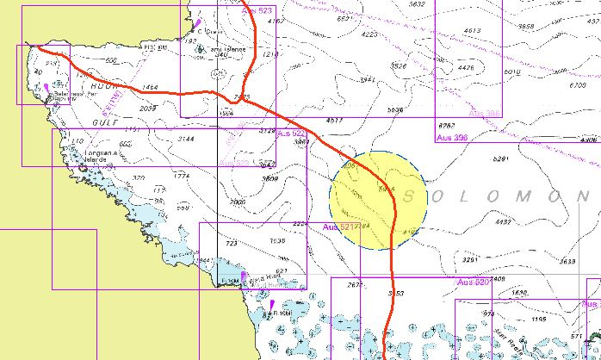
Lesson learned
Uncharted FADs impact Cable Route Survey
In 2018, 20+ uncharted FADs deployed by Fishing company over a particular sea area in the Solomon Sea affected a cable route survey that was in progress over the same area.
Nav warnings was issued for unknown no. of FADs over the area.
Actions taken
a. FAD details eventually received &
submitted for charting action
b. Relevant contact addresses for the
National Fisheries Agency & Fishing
company were added to nav warning
recipient list.

Slide 10
Points of Contact
hydro@nmsa.gov.pg
PNGMRCC@nmsa.gov.pg

